Slide 1
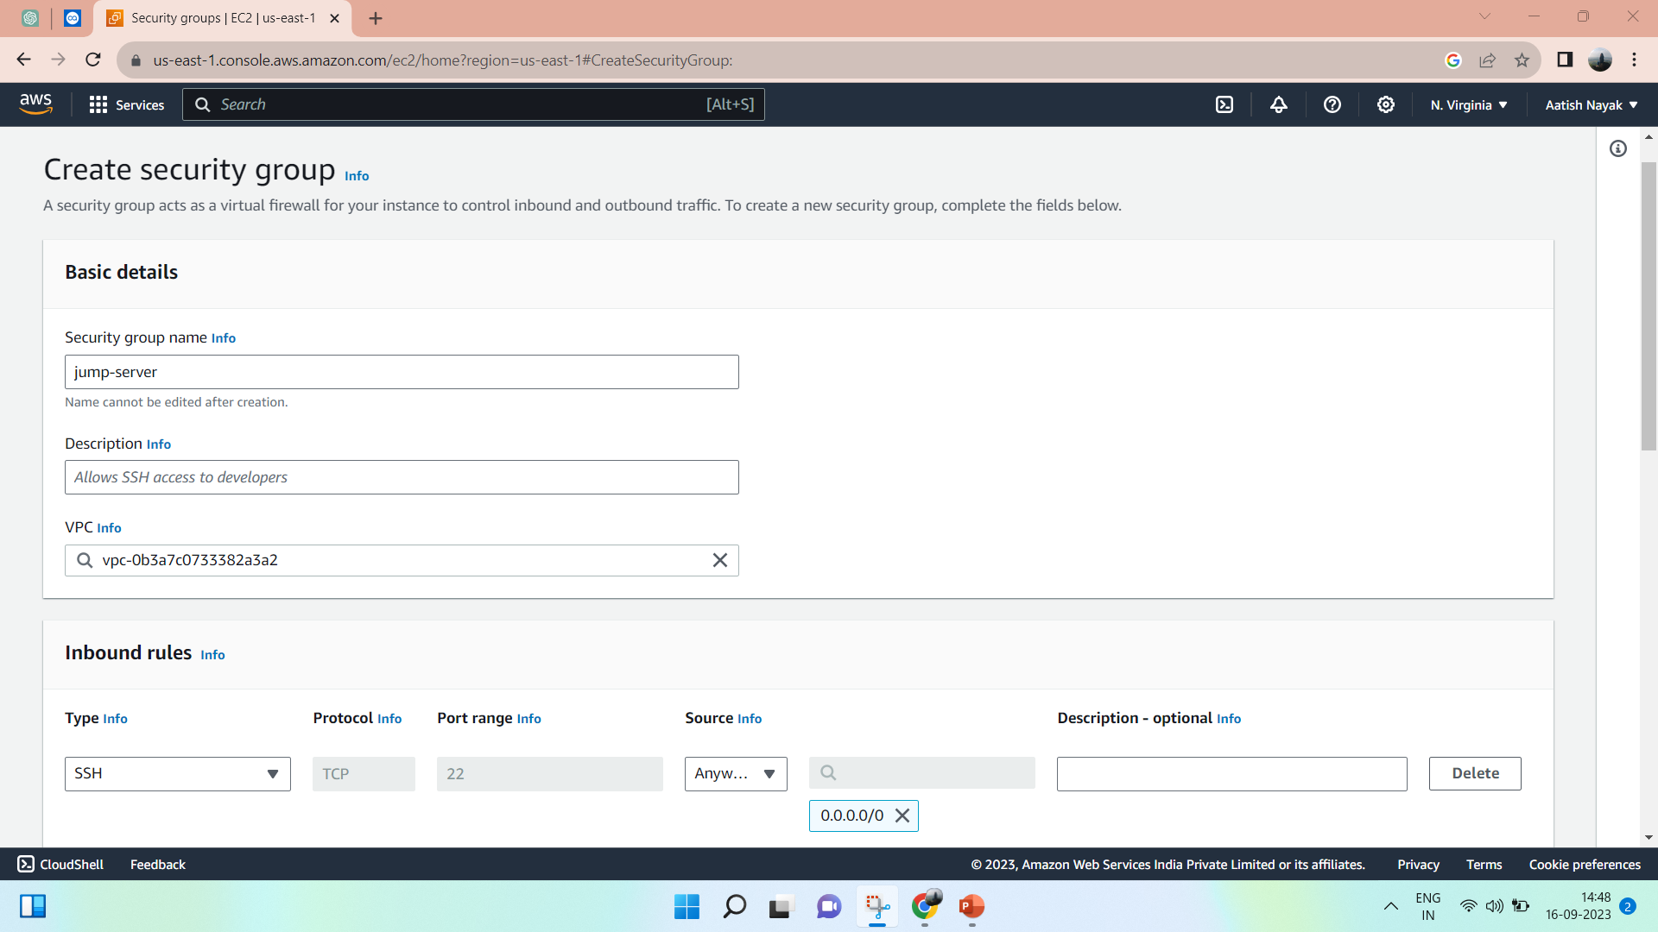
Jump server
Create security group (Jump server)
Inbound rule :- SSH , HTTP , HTTPS
Outbound rule :- All traffic

Slide 2
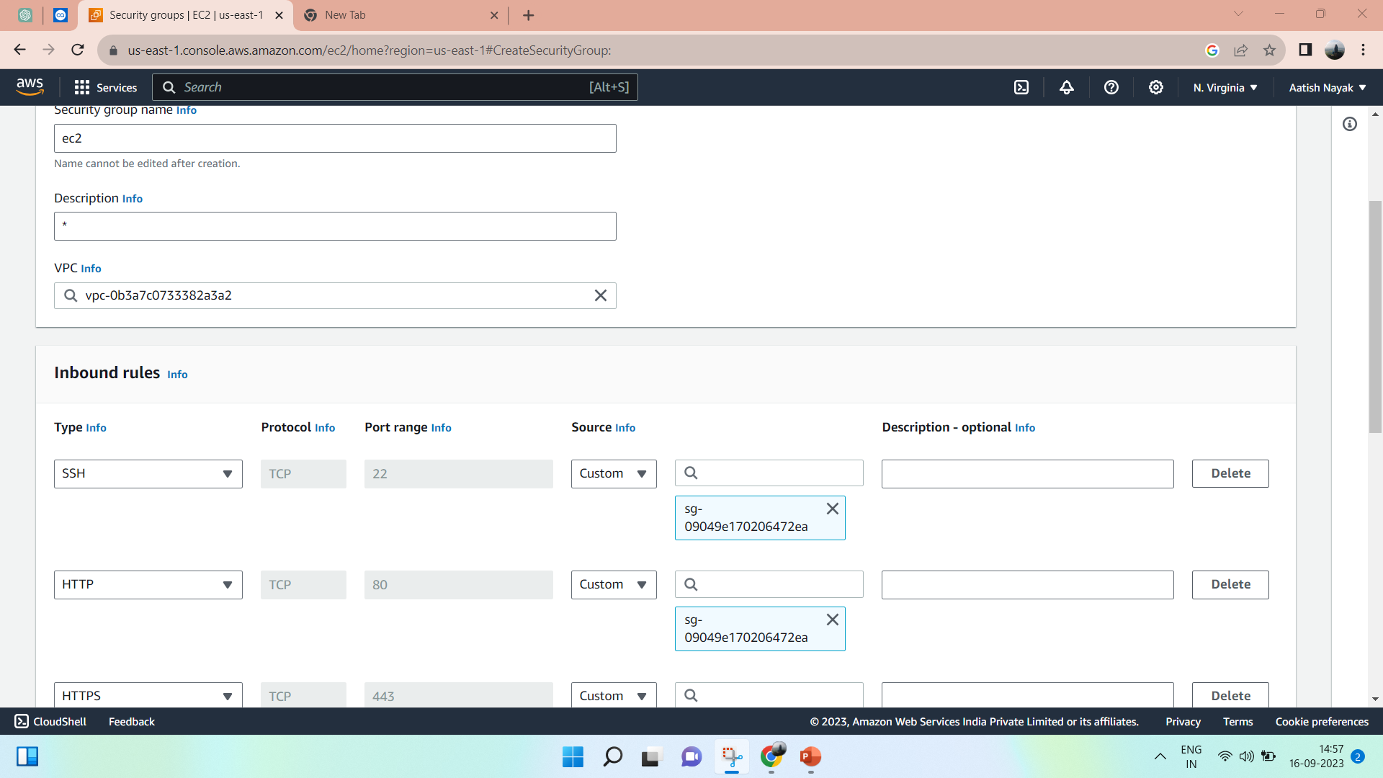
Create security group
Inbound rule : - SSH . HTTP, HTTPS
Outbound rule :- All traffic
Use source as jump server security group

Slide 3
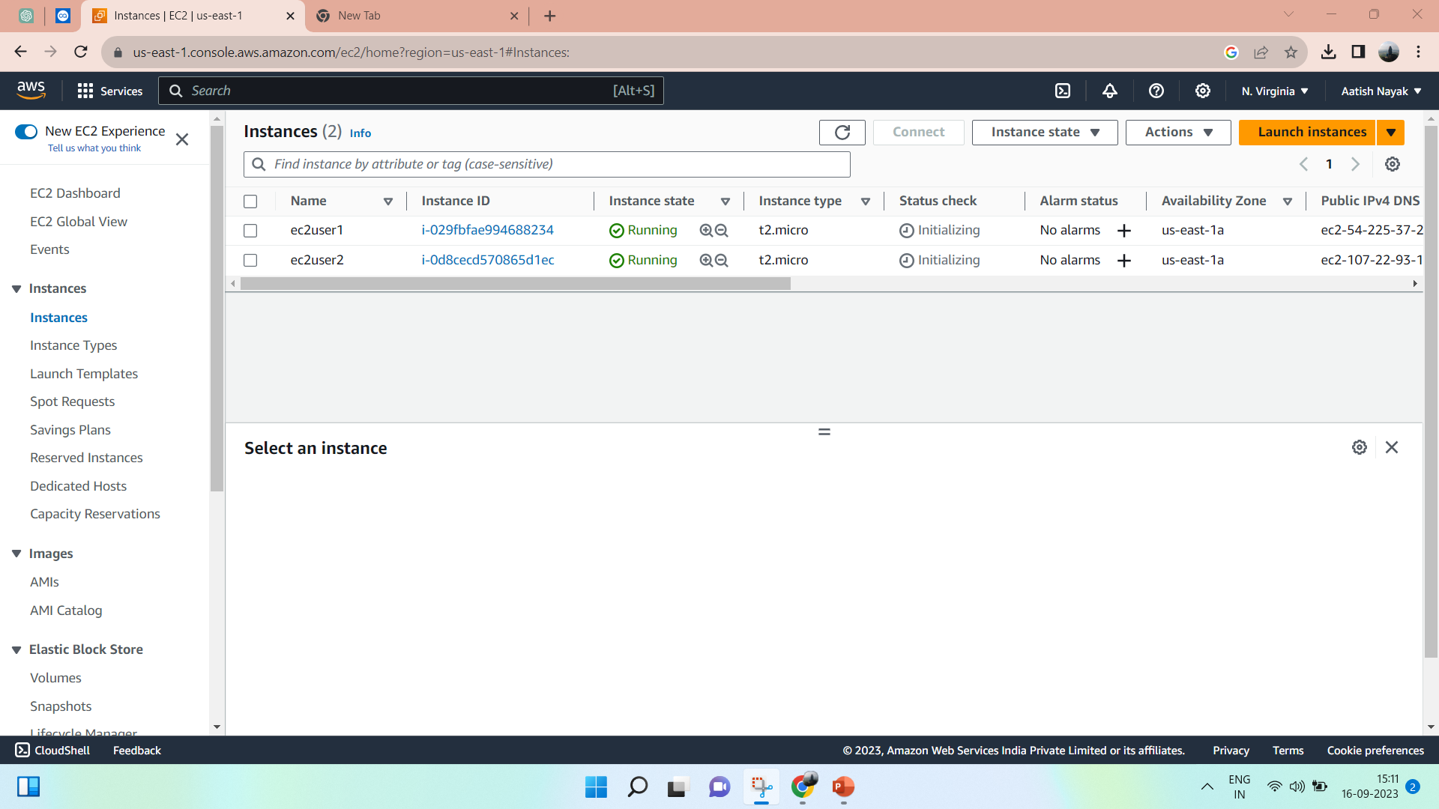
Create 2 ec2 (ubuntu)
Ec2user1 (use security group – jump server)
Ec2user2 (use security group – ec2 server)

Slide 4
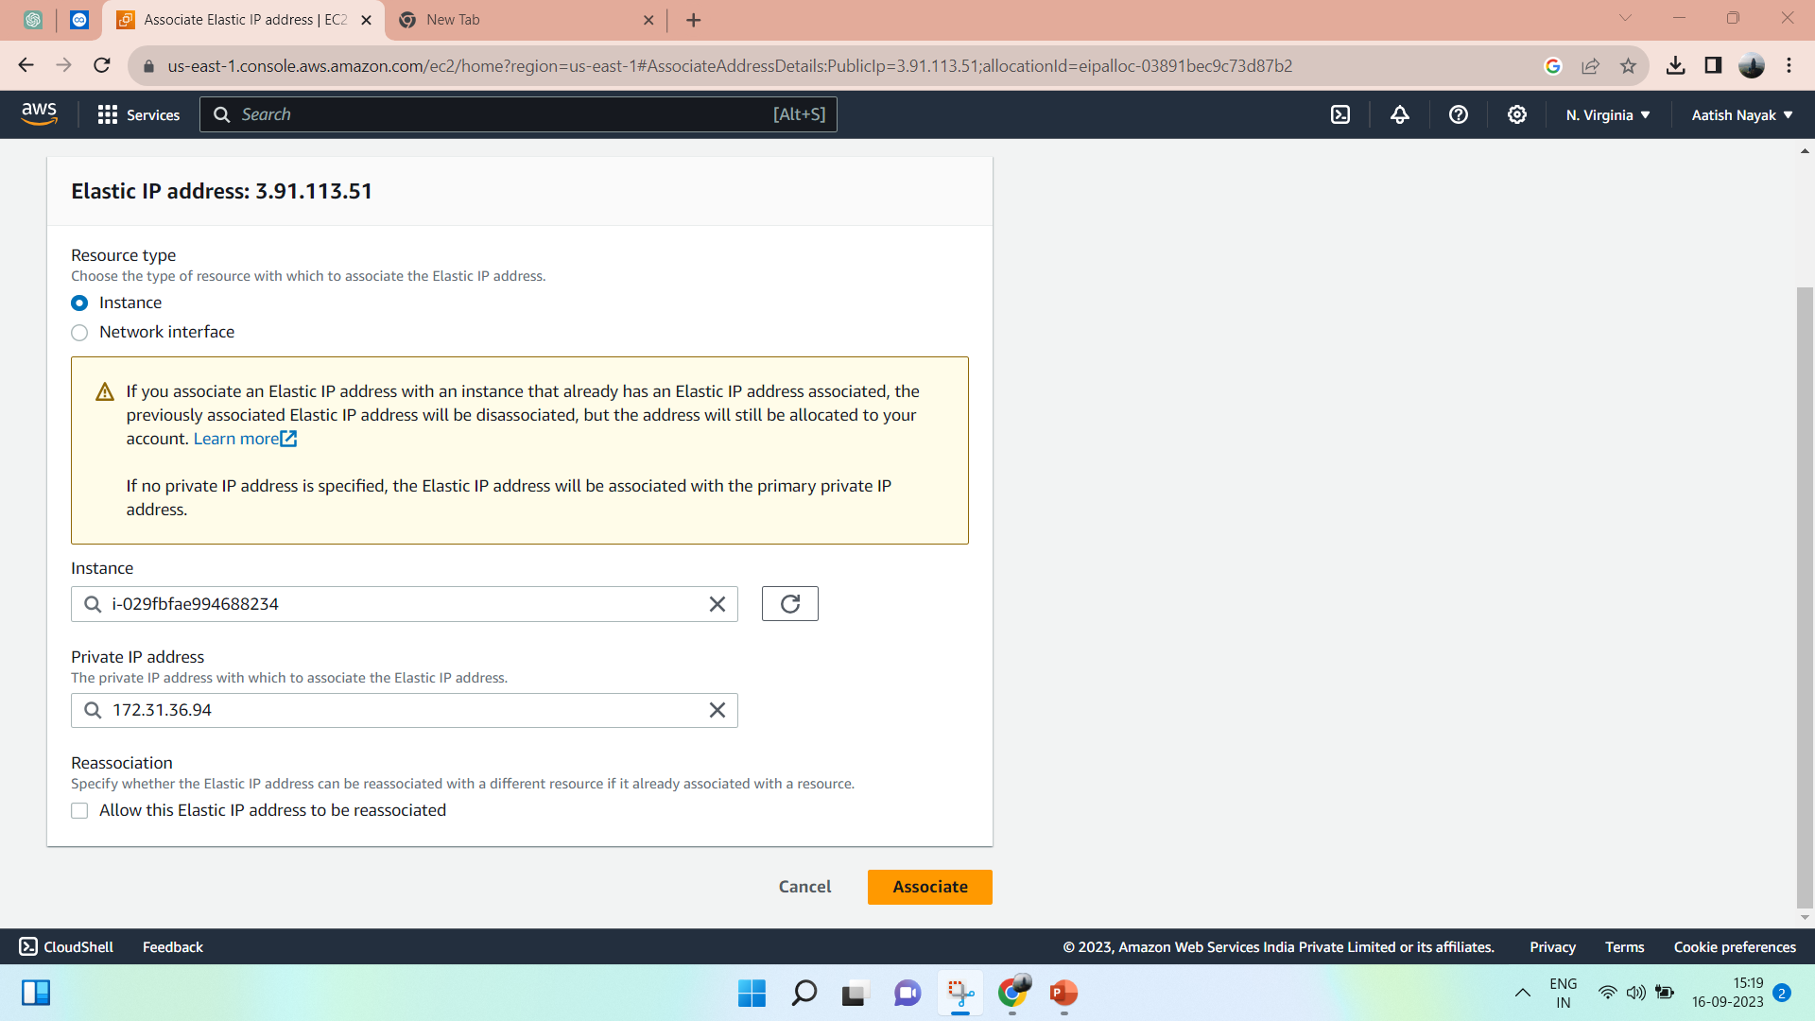
Create elastic IP
Allocate (default settings)
Click on IP
Associate elastic IP
Select ec2user1 (jump server)

Slide 5
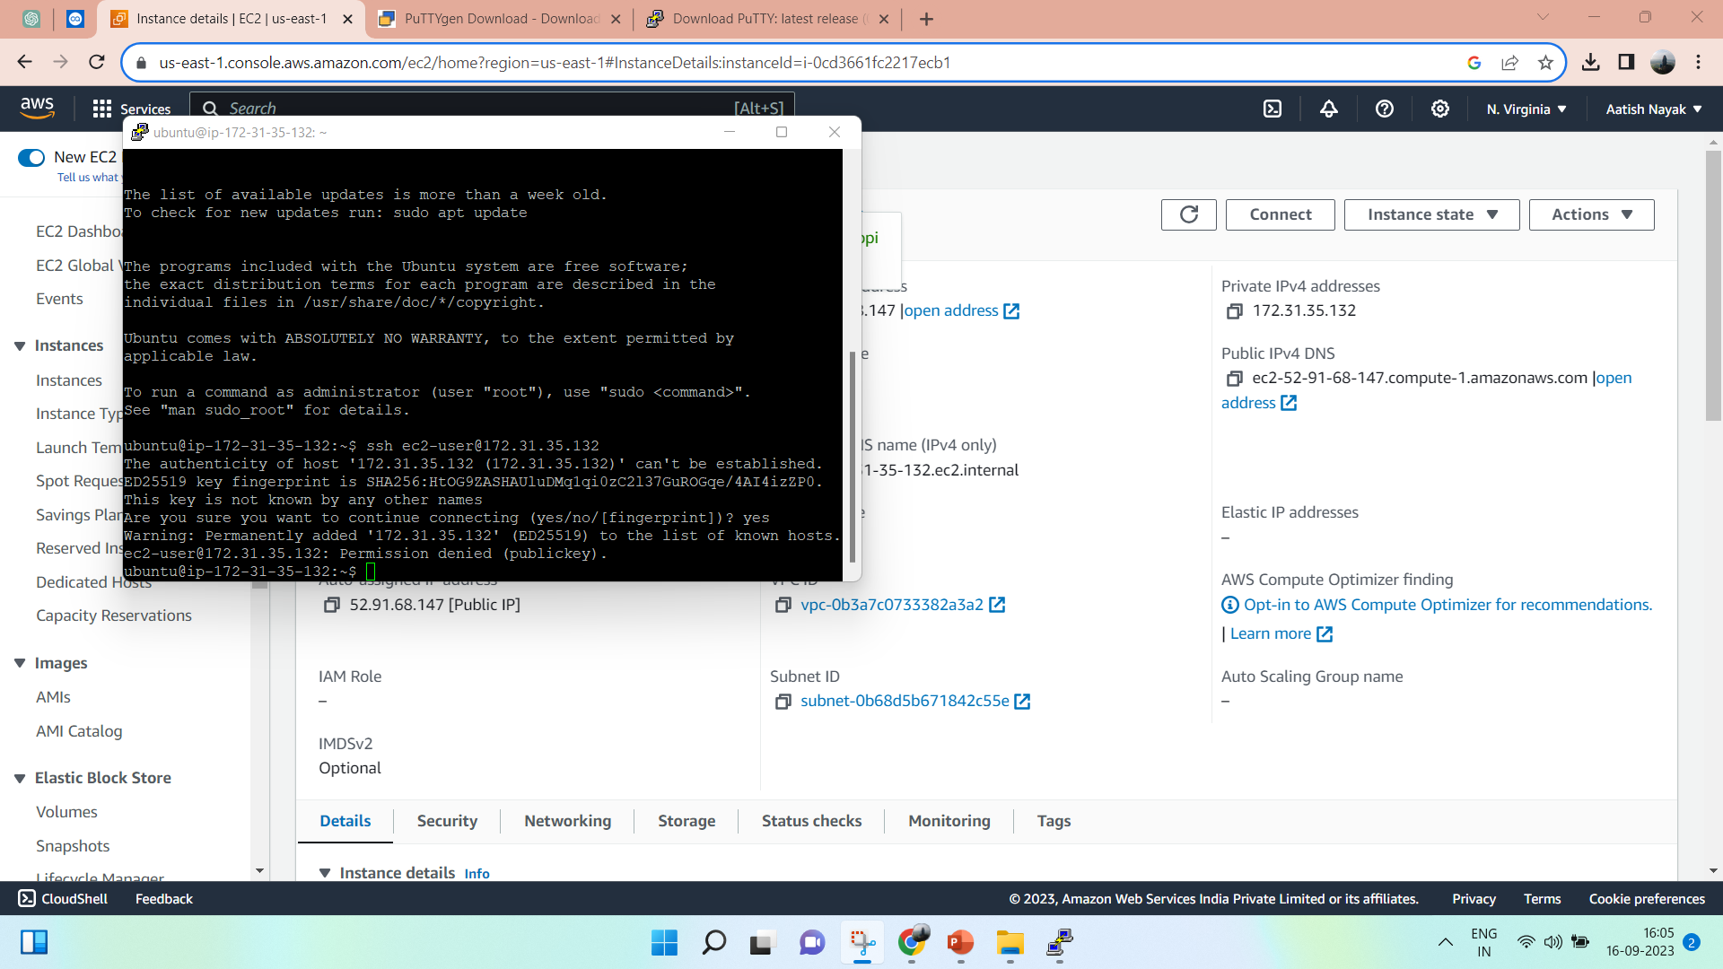
Converted pem key into ppk using putty gen
Save private key
Orelse if we have ppk key
Add public ip as host
Ssh –auth-agent forwarding
Once connected
Ssh ec2-user@privateip

